Slide 1
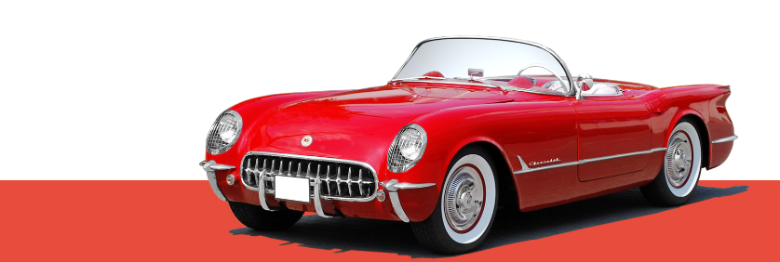
Automobile Data Analysis
Lagna ray

Slide 2
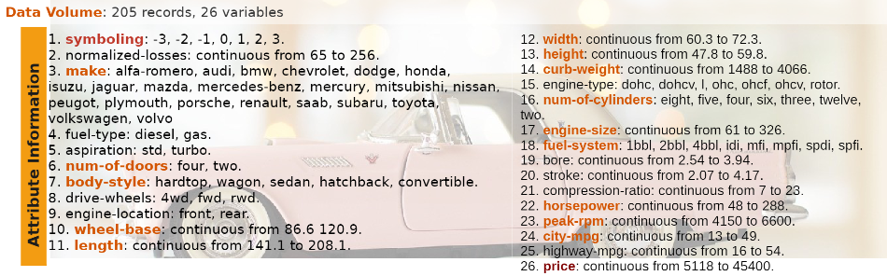
Data source and Data Dictionary
DATASET SOURCE: https://archive.ics.uci.edu/ml/dataset/automobile

Slide 3
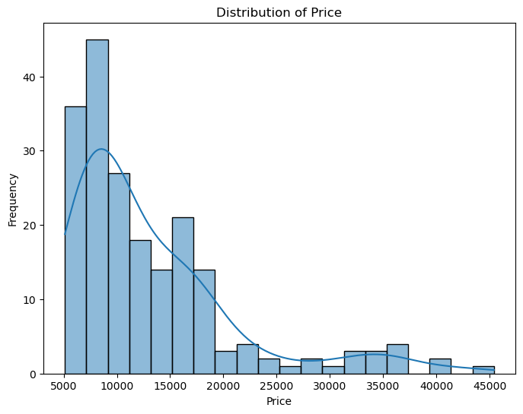
Distribution of Price
ANALYSIS:
Majority of cars falls between price range of 5000 to 20000

Slide 4
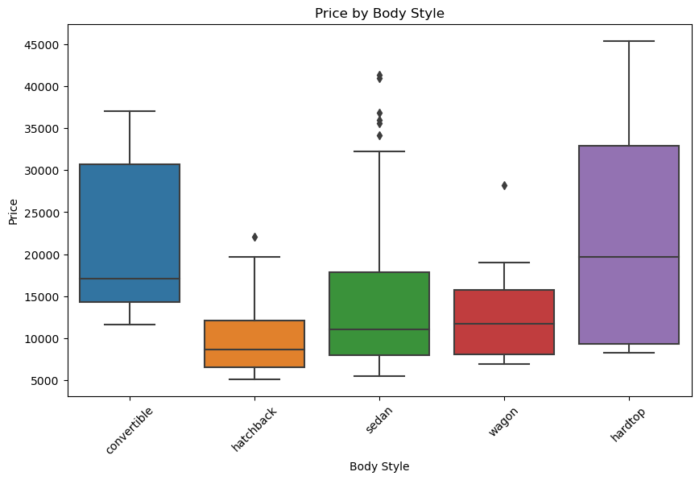
Relation between body style and Price
ANALYSIS:
Convertible and hardtop are more expensive than hatchback

Slide 5
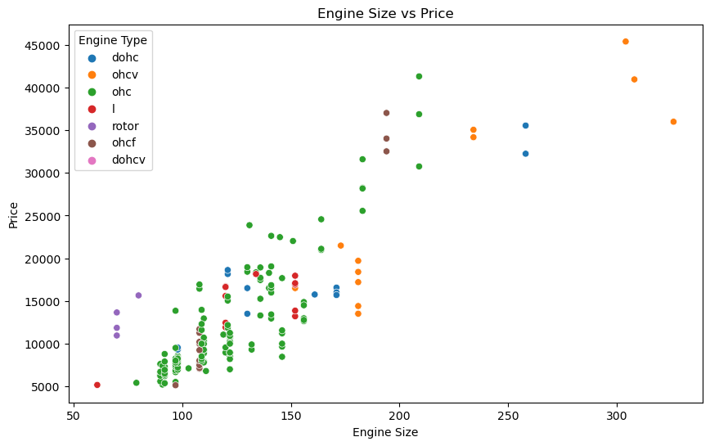
Relationship between engine size and price
ANALYSIS:
Larger is the engine size , higher is the prices due to increased power and performance

Slide 6
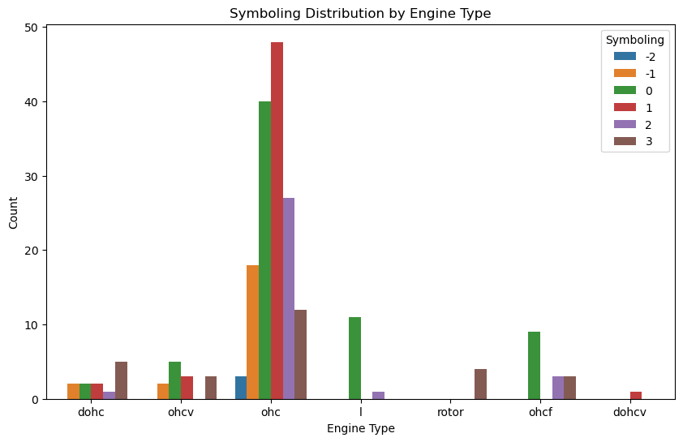
Relationship between symboling and engine type
ANALYSIS:
ohc engine type are more riskier

Slide 7
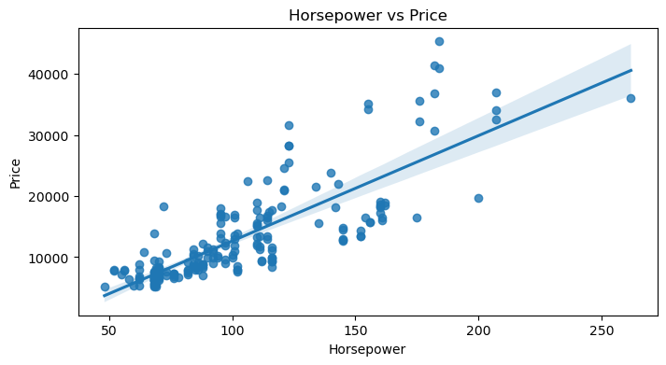
Relationship between Horse Power vs Price
ANALYSIS:
The regression line has a positive slope, indicating that as horsepower increases, the price of the automobile tends to increase as well. There is a positive correlation between horsepower and price

Slide 8
Relationship between horsepower and city mpg
ANALYSIS:
The regression line has a positive slope, indicating that as horsepower increases, the price of the automobile tends to increase as well. There is a positive correlation between horsepower and price

Slide 9
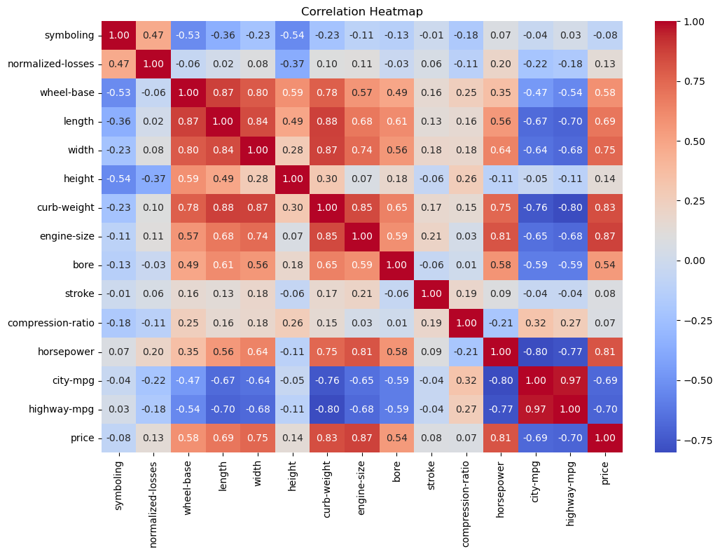
Correlation Heatmap
ANALYSIS:
The engine size ,bore ,horse-power have positive correlation with price. Whereas city-mpg and high-way mpg have negative correlation with price.

Slide 10
Thank You

